Slide 1

Application layer: overview
Principles of network applications
Socket programming with UDP and TCP
Application architectures
Web and HTTP
The Domain Name System DNS
E-mail, SMTP, POP3, IMAP

Slide 2
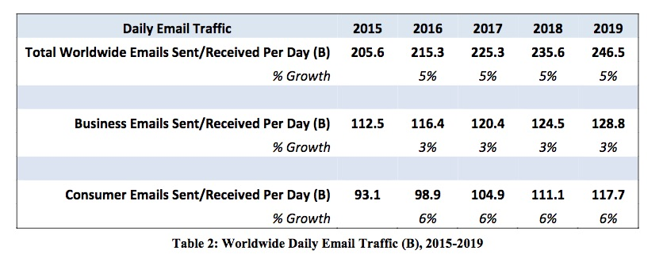
Introduction
Another network application!
Asynchronous in nature
People can send, receive and read messages at any time
Incredibly popular and widely used

Slide 3
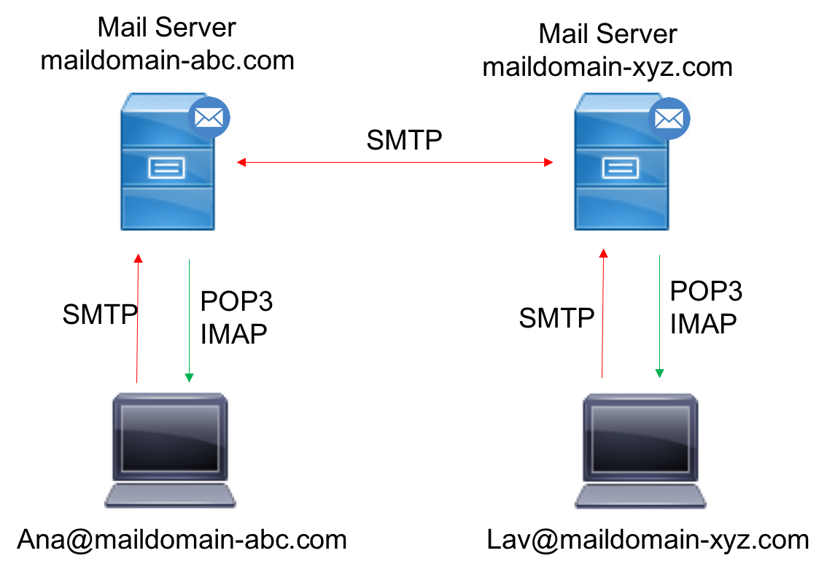
E-mail
Three major components:
user agents
mail servers
communication protocols:
simple mail transfer protocol: SMTP
post office protocol 3 (POP3)
Internet mail access protocol (IMAP)
User Agent
a.k.a. “mail reader”
composing, editing, reading mail messages
e.g., Outlook, iPhone mail client
outgoing, incoming messages stored on server

Slide 4

E-mail: mail servers
outgoing
message queue
user mailbox
user
agent
mail servers:
mailbox contains incoming messages for user
message queue of outgoing (to be sent) mail messages
SMTP protocol between mail servers to send email messages
client: sending mail server
“server”: receiving mail server
mail
server
user
agent
SMTP
mail
server
user
agent
SMTP
SMTP
user
agent
mail
server
user
agent
user
agent

Slide 5
Simple Mail Transfer Protocol (RFC 5321)
uses TCP to reliably transfer email messages from client (mail server initiating connection) to server
Runs over port 25
direct transfer: sending server (acting like client) to receiving server
three phases of transfer
handshaking (greeting):
once the TCP connection is established, the server and client perform some application-layer handshaking; during the handshaking phase, SMTP client indicates the email addresses of the sender and the recipient
transfer of messages
closure
command/response interaction (like HTTP)
Commands (client): ASCII text, e.g., HELO, MAIL FROM, RCPT TO, DATA, QUIT
Response (server): status code, e.g., 220, 250, 354 etc and some phrase

Slide 6


Scenario: Alice sends e-mail to Bob
1) Alice uses UA to compose e-mail message “to” bob@someschool.edu
4) SMTP client sends Alice’s message over the TCP connection
2) Alice’s UA sends message to her mail server; message placed in message queue
5) Bob’s mail server places the message in Bob’s mailbox
3) client side of SMTP opens TCP connection with Bob’s mail server
6) Bob invokes his user agent to read message
user
agent
mail
server
user
agent
1
mail
server
2
3
6
4
Alice’s mail server
5
Bob’s mail server

Slide 7
Intermediate Servers
SMTP does not use intermediate mail servers to send mail
Even if the mail servers are on the other side of world
If Alice’s server is in Lancaster, and Bob’s server is in Weihai, the TCP connection is a direct connection between the two servers
If Bob’s mail server is down not receiving additional messages, the message will remain on Alice’s mail server in Lancaster and wait for a new attempt
It does not get placed in an intermediate server

Slide 8
SMTP: Final Words
SMTP uses persistent connections
If the sending mail server has several messages to send to the same receiving mail server, it can send all of the messages over the same TCP connection.
For each message, the client begins the process with a new MAIL FROM: command, designates the end of message with an isolated period, and issues QUIT only after all messages have been sent.
SMTP requires message (header & body) to be in 7-bit ASCII
SMTP server uses CRLF.CRLF to determine end of message
CR and LF stand for carriage return and line feed, respectively.
Notes:
CRLF = \r, \n.

Slide 9
Comparison to HTTP
SMTP | HTTP
Transfers files (email messages) from one mail server to another mail server | Transfers files (also called objects) from a Web server to a Web client (typically a browser)
Push protocol --- the sending mail server pushes the file to the receiving mail server | Pull protocol --- someone loads info on a Web server and users use HTTP to pull the info from the server
The TCP connection is initiated by the machine that wants to send the file | The TCP connection is initiated by the machine that wants to receive the file
Enforces 7-bit ASCII format | No format restrictions
Multiple objects sent in multipart message | Each object encapsulated in its own response message
Uses persistent connections | Persistent HTTP use persistent connections
Have ASCII command/response interaction, status codes | Have ASCII command/response interaction, status codes
Notes:
In SMTP, If the message contains characters that are not 7-bit ASCII (for example, French, German, Japanese, Chinese characters, etc) or contains binary data (such as an image file), then the message cannot be directly transmitted using SMTP. In that case, Multipurpose Internet Mail Extension (MIME) can be used to transform non-ASCII data at sender side to 7-bit ASCII data. MIME is a kind of add-on or a supplementary protocol that allows non-ASCII data to be sent through SMTP. (we won’t touch on MIME in this course.)

Slide 10
Mail Message Format [RFC 822]
Standard for text message format
Header
Required multiple lines:
To
From
Subject
Body
The “message”
ASCII characters only
Header
Blank line
Body
Notes:
It is important to note that these header lines are different from the SMTP commands we studied in previous slide (even though they contain some common words such as “from” and “to”).
The commands in that section were part of the SMTP handshaking protocol; the header lines examined in this section are part of the mail message itself

